Slide 1

TEAM MEMBERS:
M.Ramya (JNTUHCEH)
A. Sai Joshitha (JNTUHCEH)
T. Indu (JNTUHCEH)
Md.Hafiza Rizwana (Sri Vishnu Engineering College for Women)

Slide 2
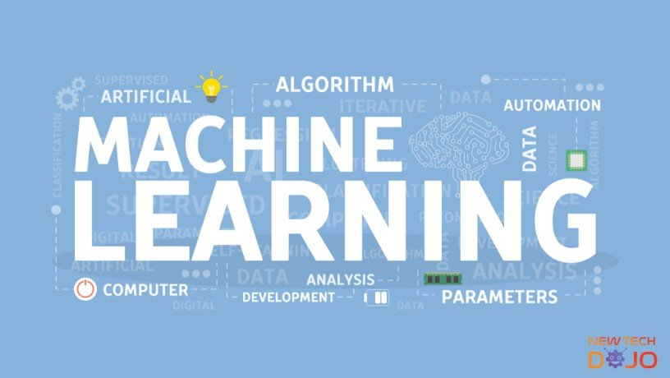
An Intro:

Slide 3
Machine Learning with Python
Machine learning is a part of artificial intelligence (AI) that provides computers with the ability to learn without being explicitly programmed.
Python community has developed many modules to help programmers implement machine learning.
Machine learning involves computer to get trained using a given data set, and use this training to predict the properties of a given new data.

Slide 4

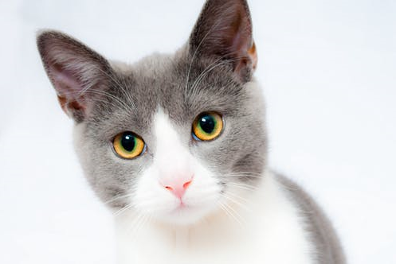
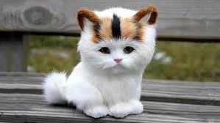
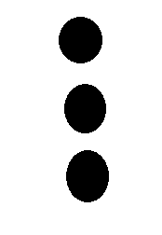
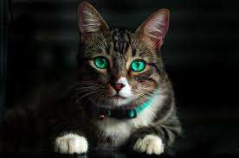

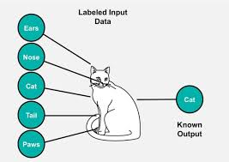
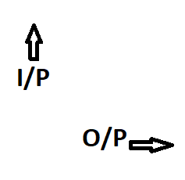

Slide 5
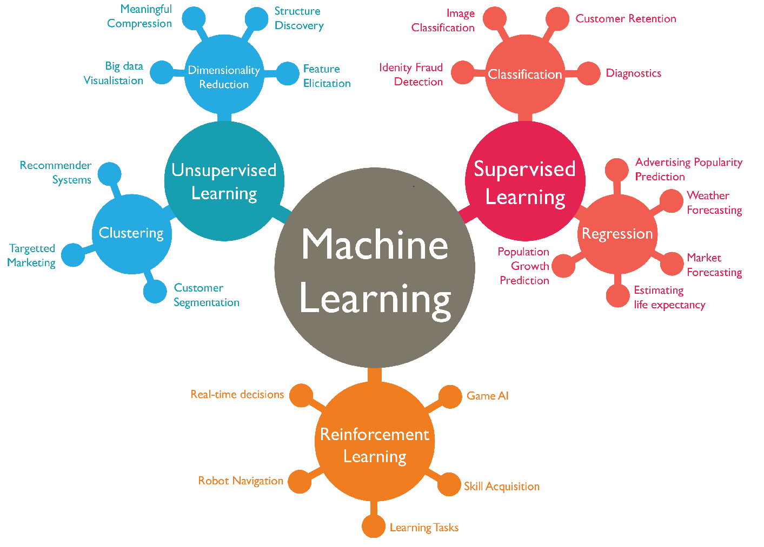

Slide 6
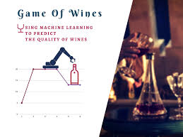
PREDICTING THE QUALITY OF RED WINE

Slide 7
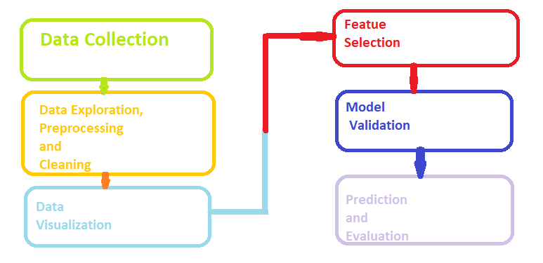
Steps followed for “Predicting The Quality Of Wine- Red”

Slide 8
Brief explanation of the steps
DATA COLLECTION
Data collection is the process of gathering and measuring information from countless different sources.
By using Machine Learning solutions ,we store data in a way that makes sense for the business problem at hand.
DATA PREPROCESSING
A technique that is used to convert the raw data into a clean data set.
In other words, whenever the data is gathered from different sources it is collected in raw format which is not feasible for the analysis.
It includes –
Data Cleaning
Data Integration
Data Transformation
Data Reduction

Slide 9
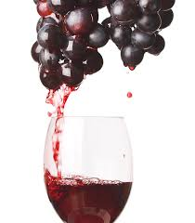
DATA COLLECTION REGARDING OUR PROJECT
1. Name: Wine Quality Data Set
2. Input variables:
fixed acidity
volatile acidity
citric acid
residual sugar
chlorides
free sulfur dioxide
total sulfur dioxide
density
pH
alcohol
3. Output variable: Quality (score between 3 and 8)
4. Number of Observations: 1599
5. Number of Attributes/Variables: 12
6. Missing Values: N/A

Slide 10
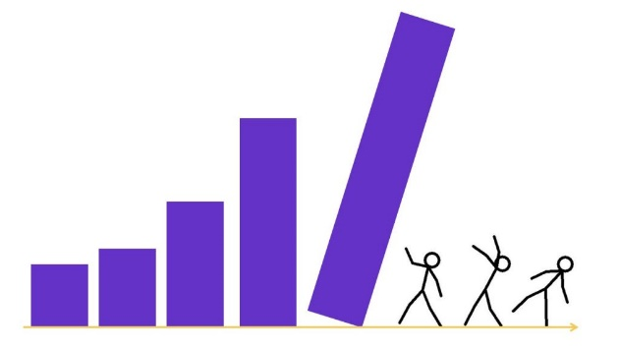
Brief explanation of the steps
DATA VISUALIZATION
Data visualization is the graphical representation of information and data.
By using visual elements like charts, graphs, and maps, data visualization tools provide an accessible way to see and understand trends, outliers, and patterns in data.
FEATURE SELECTION
Feature Selection is the process where you automatically or manually select those featureswhich contribute most to your prediction variable or output in which you are interested in.
Having irrelevant features in your data can decrease the accuracy of the models and make your model learn based on irrelevant features.

Slide 11
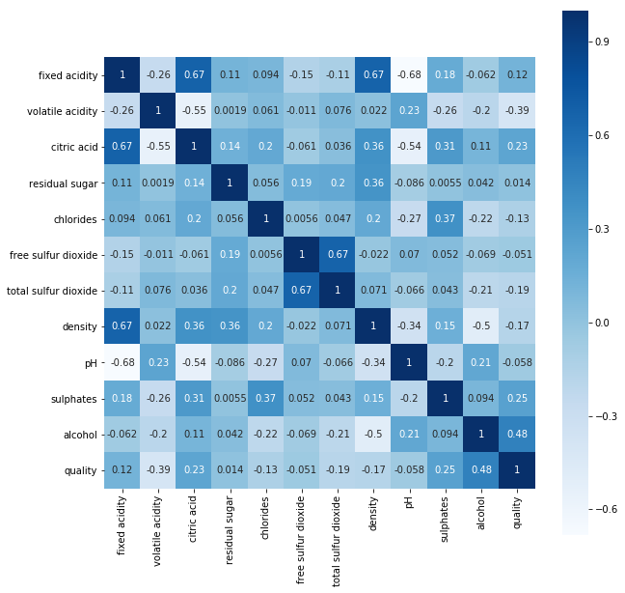
CORRELATION OF ATTRIBUTES

Slide 12
Common Machine Learning Algorithms
CLASSIFICATION:
Logistic Regression(SL)
Decision Tree (SL)
SVM [Support Vector Machine](SL)
Naive Bayes (SL)
KNN[K-Nearest Neighbourhood] (SL)
Random Forest (SL)
REGRESSION:
Linear Regression (SL)
Multiple Regression(SL)

Slide 13
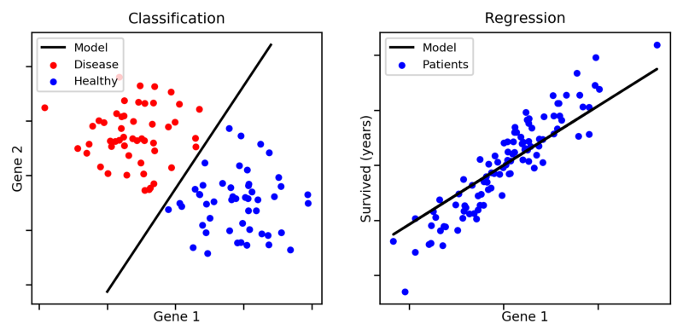
Is this a regression task or
a classification task?

Slide 14
WHY CLASSIFICATION?
There are models which will treat each class of the wine separately and their aim is to find decision boundaries that work well for new unseen data.
These are the classifiers.
On the other hand we have models which are able to predict in between numbers and thus have as output 5.4 or 7.1 instead of pure classes. These are the regressors.
In this project we are exploring classifiers.
Binary classifiers
Multi class
classifiers

Slide 15
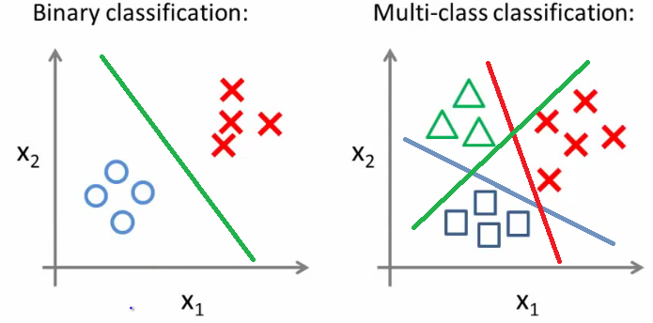
MULTI CLASS CLASSIFIERS:
K Nearest Neighbours
Decision tree
Support Vector Machine
Random Forest
Gaussian Naïve Bayes
BINARY CLASSIFIERS
Logistic Regression
Random Forest

Slide 16
Lets move on to each Algorithm in detail……….

Slide 17
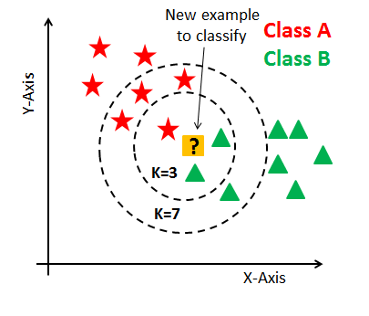
KNN:
(K- Nearest Neighbours)
It can be used for both classification and regression problems. However, it is more widely used in classification problems in the industry.
K nearest neighbors is a simple algorithm that stores all available cases and classifies new cases by a majority vote of its k neighbors.
The case being assigned to the class is most common amongst its K nearest neighbors measured by a distance function.

Slide 18
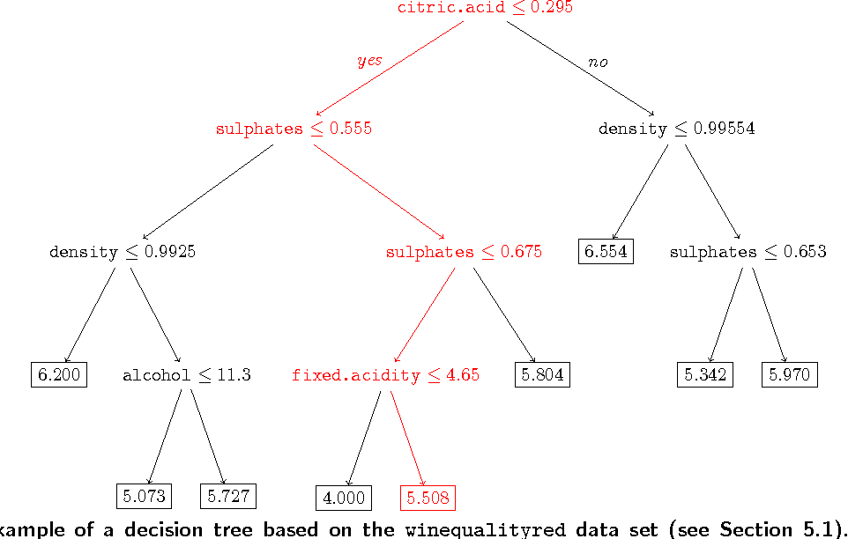
Decision Tree
It is a type of supervised learning algorithm that is mostly used for classification problems.
In this algorithm, we split the population into two or more homogeneous sets.

Slide 19
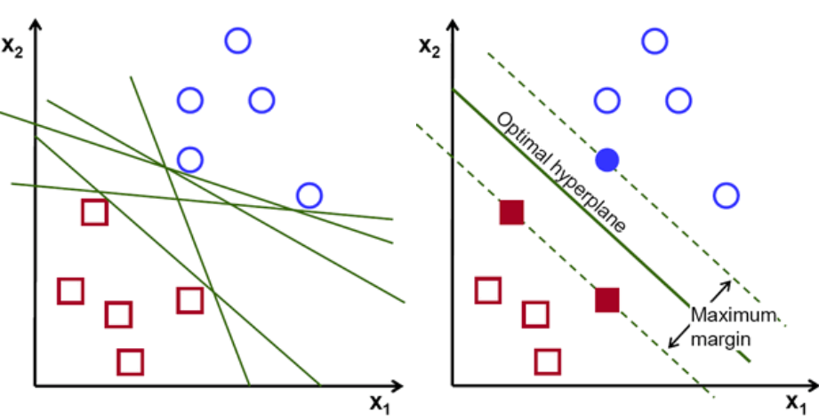
SVM (Support Vector Machine)
It is a classification method.
In this algorithm, we plot each data item as a point in n-dimensional space (where n is number of features you have) with the value of each feature being the value of a particular coordinate.

Slide 20
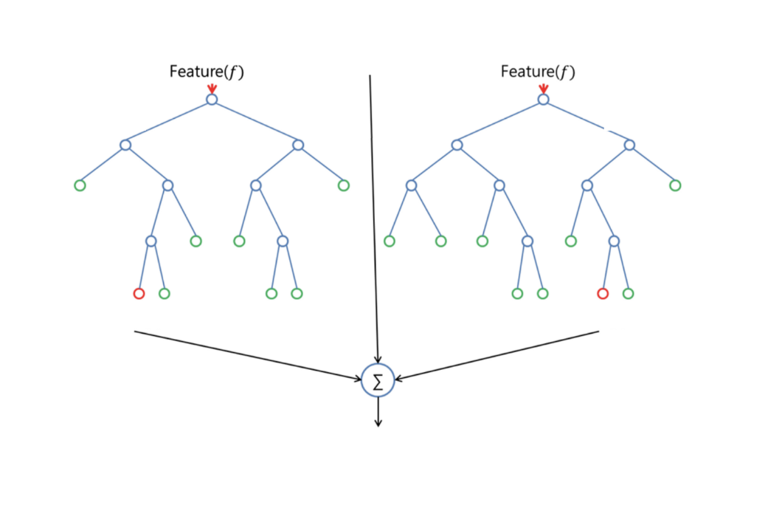
Random Forest
Random Forest is a trademark term for an ensemble of decision trees.
In Random Forest, we’ve collection of decision trees (so known as “Forest”).
This is used in both multi class classifiers and binary class classifiers.

Slide 21
Naive Bayes
It is a classification technique based on Bayes theorem with an assumption of independence between predictors.
In simple terms, a Naive Bayes classifier assumes that the presence of a particular feature in a class is unrelated to the presence of any other feature.

Slide 22
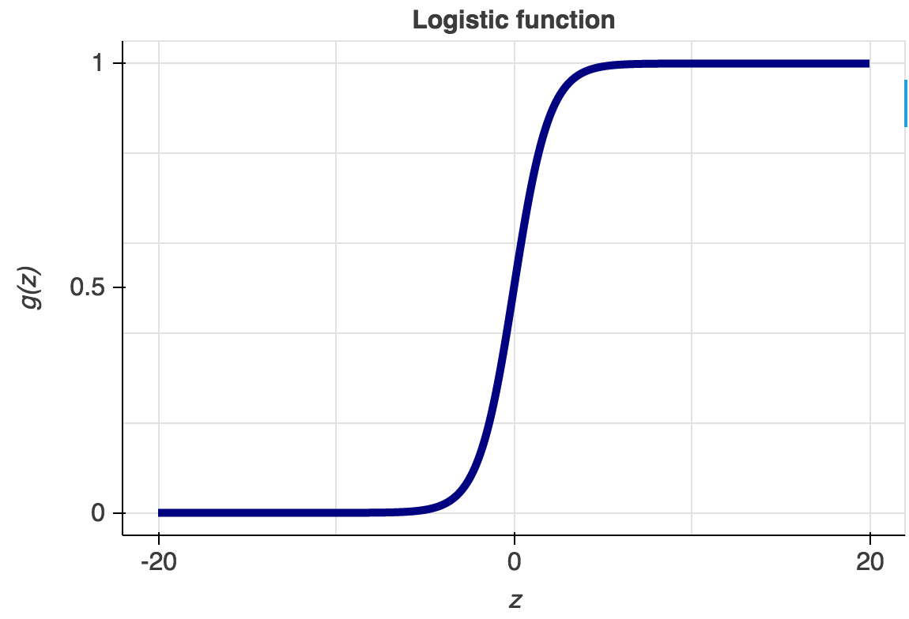
Logistic Regression
Don’t get confused by its name! It is a classification not a regression algorithm.
It is used to estimate Binary values like 0/1, yes/no, true/false based on given set of independent variable(s).
In simple words, it predicts the probability of occurrence of an event by fitting data to a logic function.Hence, it is also known as logit regression.

Slide 23
MODEL VALIDATION
In machine learning, model validation is referred to as the process where a trained model is evaluated with a testing data set.
Cross-validation is the process of assessing how the results of a statistical analysis will generalize to an independent data set.
PREDICTION AND EVALUATION
Prediction is the process of using a trained machine learning model to predict one value.
Evaluation determines how good or bad a specific machine learning model performs.

Slide 24
ACCURACY CHART (Multi Class Classifiers)
Sl.no | Classification model | Test size | Accuracy(%) | Cross_val Accuracy(%)
 | Multiclass classifiers
1. | KNN model | 0.1 | 60% | 48.5%
 |  | 0.25 | 56% | 48.5%
 |  | 0.4 | 52.1% | 48.5%
2. | Decision tree | 0.1 | 60% | 53.7%
 |  | 0.25 | 59.5% | 53.9%
 |  | 0.4 | 62.3% | 53.85%
3. | SVM | 0.1 | 62.5% | 48.9%
 |  | 0.25 | 57.75% | 48.9%
 |  | 0.4 | 53.2% | 48.9%
4. | Random Forest | 0.1 | 69.3% | 57.36%
 |  | 0.25 | 65.25% | 56.2%
 |  | 0.4 | 63.5% | 55.49%
5. | Gaussian Naive Bayes | 0.1 | 60.6% | 55.67%
 |  | 0.25 | 56.5% | 55.6%
 |  | 0.4 | 56.0% | 55.67%

Slide 25
ACCURACY CHART (Binary Class Classifiers)
Sl.no | Classification model | Test size | Accuracy(%) | Cross_val Accuracy(%)
1. | Logistic Regression | 0.1 | 90.6% | 86.49%
 |  | 0.25 | 90.5% | 86.49%
 |  | 0.4 | 88.7% | 86.49%
2. | Random Forest | 0.1 | 91.2% | 87.8%
 |  | 0.25 | 91% | 87.5%
 |  | 0.4 | 90.5% | 87.2%

Slide 26
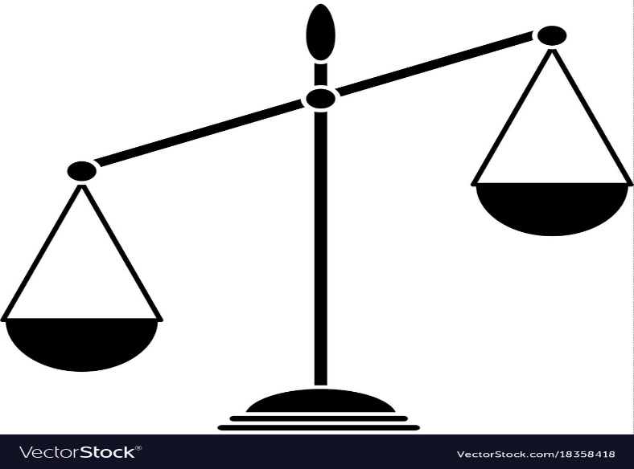
Which is best?
Multi
classifiers
Binary classifiers
Multiclass
classifiers:
Decision Tree
SVM
Naive Bayes
KNN
Random Forest
Have less accuracy in the range of 55% to 65%.
Binary classifiers:
Logistic Regression
Random Forest
Have more accuracy in the range of 82% to 92%.

Slide 27


